Slide 1
Thinkers
The left brain or the right brain?
Does it matter to the pnal performance??

Slide 2
A common sense
The sample from me
catalogue
Scientists’ View
HHHHHHHHow to proceed in Education

Slide 3
Part 01
Common Sence
HHHHhow people think usually

Slide 4
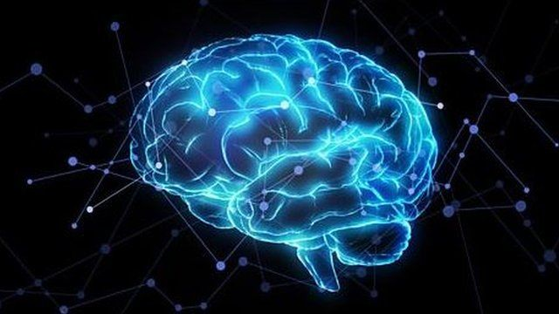

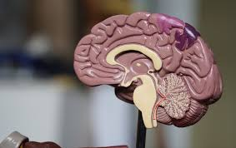
Work Completion
添加
标题
添加
标题
.
left or right?

Slide 5
Common Sense
Hhow people think usually
Students may have different performance in the class
Performance
”’’’’’’”They are using different part of brain”
Teacher says...
So people actually have a dominant brain, so....
I thought..

Slide 6

MMEPart 02
Do I have saxmple?

Slide 7
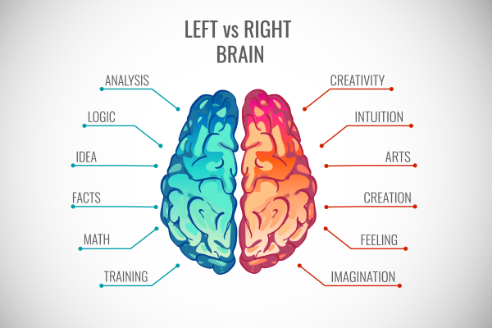
Sample from me
how I was judged
B

Slide 8

Part 03
scientists’ view

Slide 9
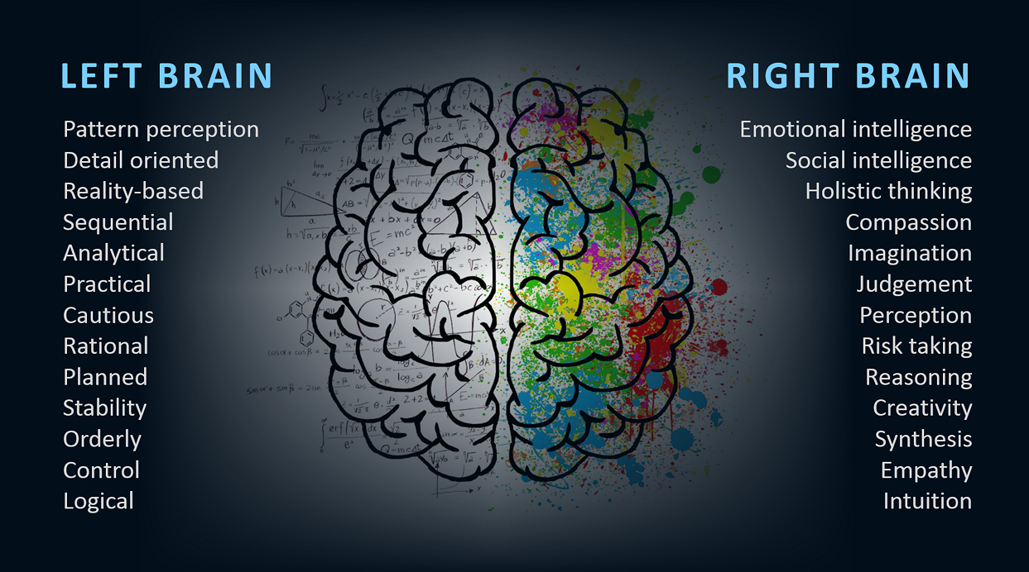
scientists view
no difference
NOnon- biased

Slide 10

Part 04
Hhow to do
.

Slide 11
Hhow to do
work as an instructor
RRreduse bias
As a teacher, one should know that there is no obvious left or right brain users.
to instruct
UIf I was the teacher, I would...

Slide 12
At last
Thank you

