Slide 1
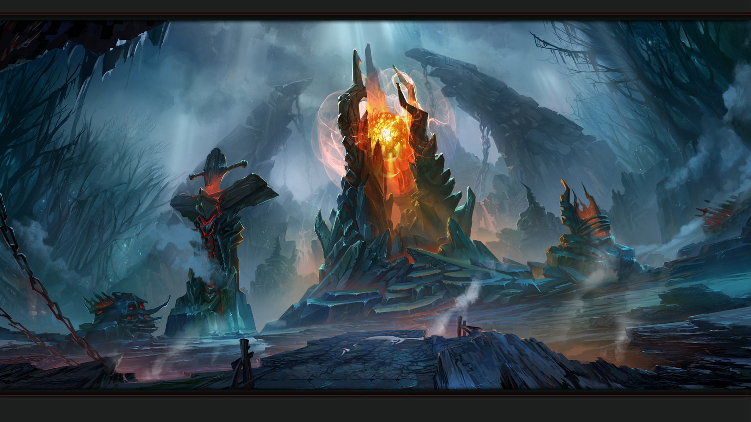
League of Legends Beginner's Guide
不破不立

Slide 2

1.Basic operation keys
Move
Attack
Skill keys
Buy equipment
Right mouse button: Champion move
A: Click “A” and select the target with the left mouse button.
Champion skills：
Q 、W、 E 、R
Summoner Spells：
D 、F
All equipment can only be purchased in esurrection point; P is the default store shortcut

Slide 3







2.Different Positions
Top
Mid
ADC
Jungle
Support
Confrontation on the top line.
Usually the opposite gank target.
Launch a preemptive attack or take damage in teamfights.
Main force output, usually mages or assassins.
Push the line and push the tower, be diligent in gank.
Week in the early stage.
Needs equipment support.
The most important position in teamfights.If ADC is alive, the team can approach victory
Clean up the jungle area and take the resources of Dragons and Baron.
Gank initiator to help teammates on other lines gain advantages
Occupy the least resources.
Protect ADC.
Launch the first attack.
Light up the field of view.

Slide 4
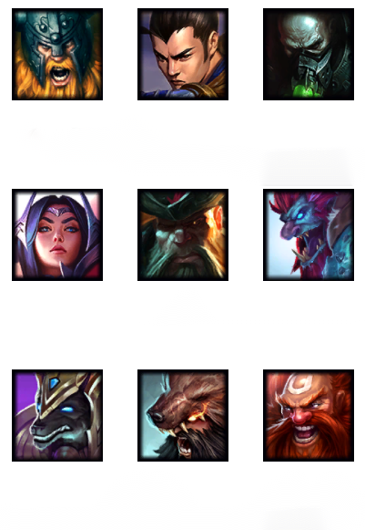
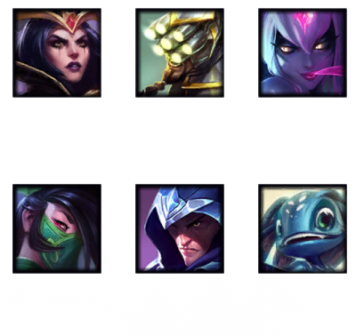
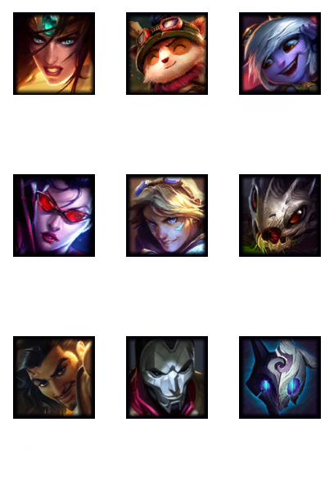
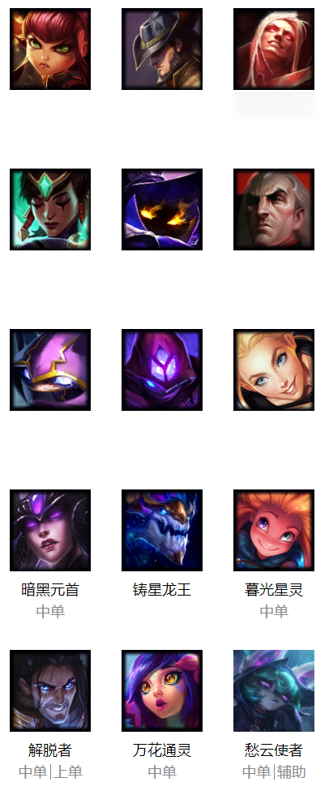
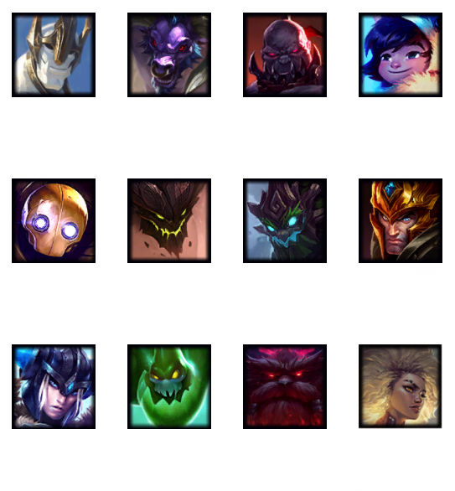
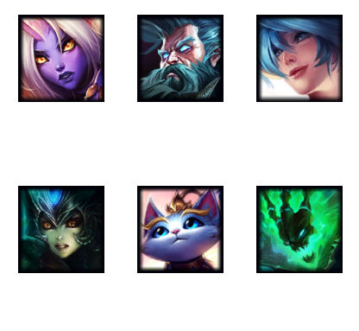
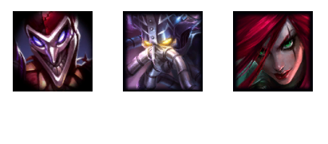
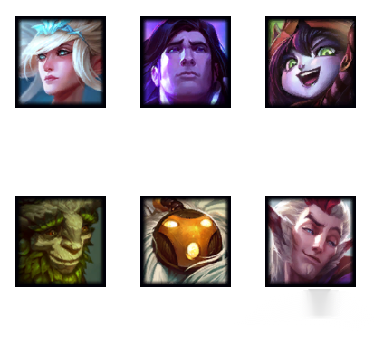
3.Champion types
Mage
Magic damage
Tank
Control&Shield
Support
Team lubricant
Bruiser
Continuation fight
Assassin
Instant burst
ADC
Remote physical output

Slide 5
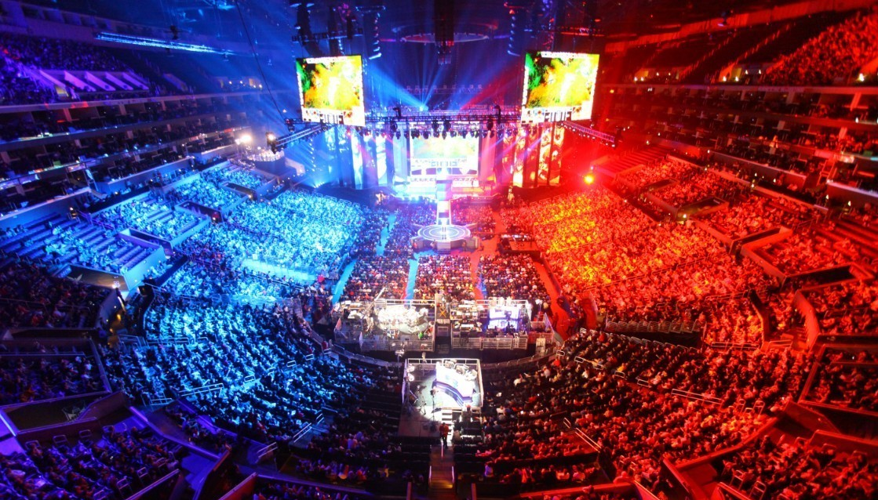

4.Jungle Resource
What is Jungle?
Kill neutral creatures in the jungle area to gain money
What monster?
Red Buff, Blue Buff, River Crab, Dragon, Baron
Why Jungle?
Conducive to gank; Utilize jungle resource
Waht should Jungle do?
Gank ＞ Kill Dragon and Baron＞ Take Buff ＞ Jungle ＞ Invade

Slide 6

5. How to win the game
Pay attention to enemy's movements and status
Comprehensive champion types
Take the initiative to fight when the other party's personnel are not available
Destory tower push line, Destroy enemy crystal hub
Try to keep a calm mind and clear thinking

Slide 7
Thank you
不破不立

